Slide 1


Capstone project PITCH
Nelson Dsouza
Maria George
Saurabh SetH

Slide 2
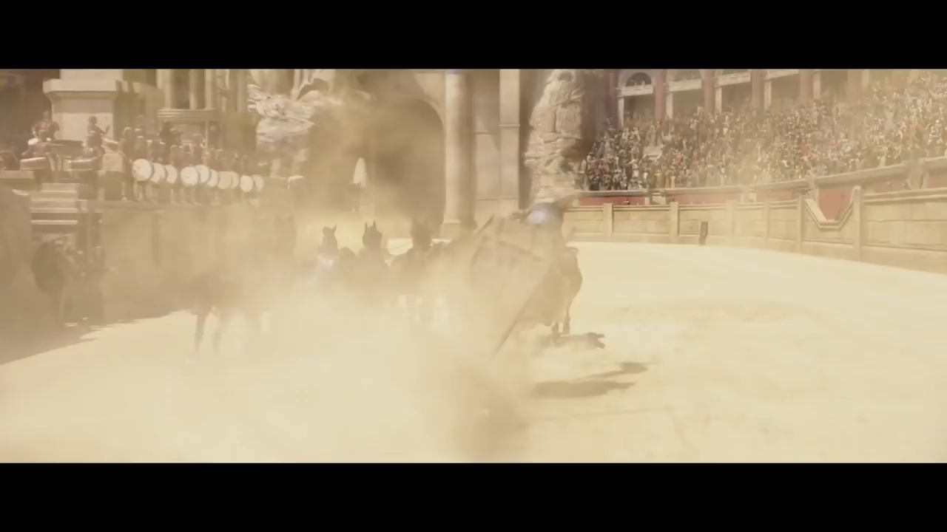
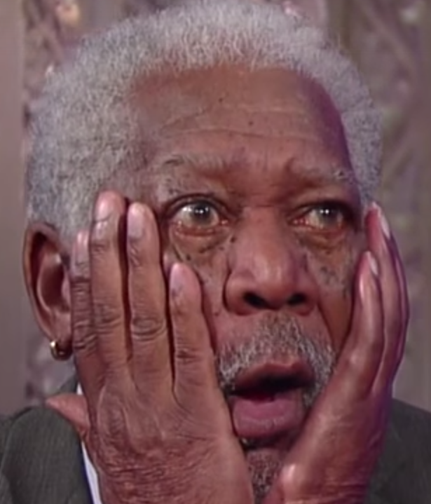
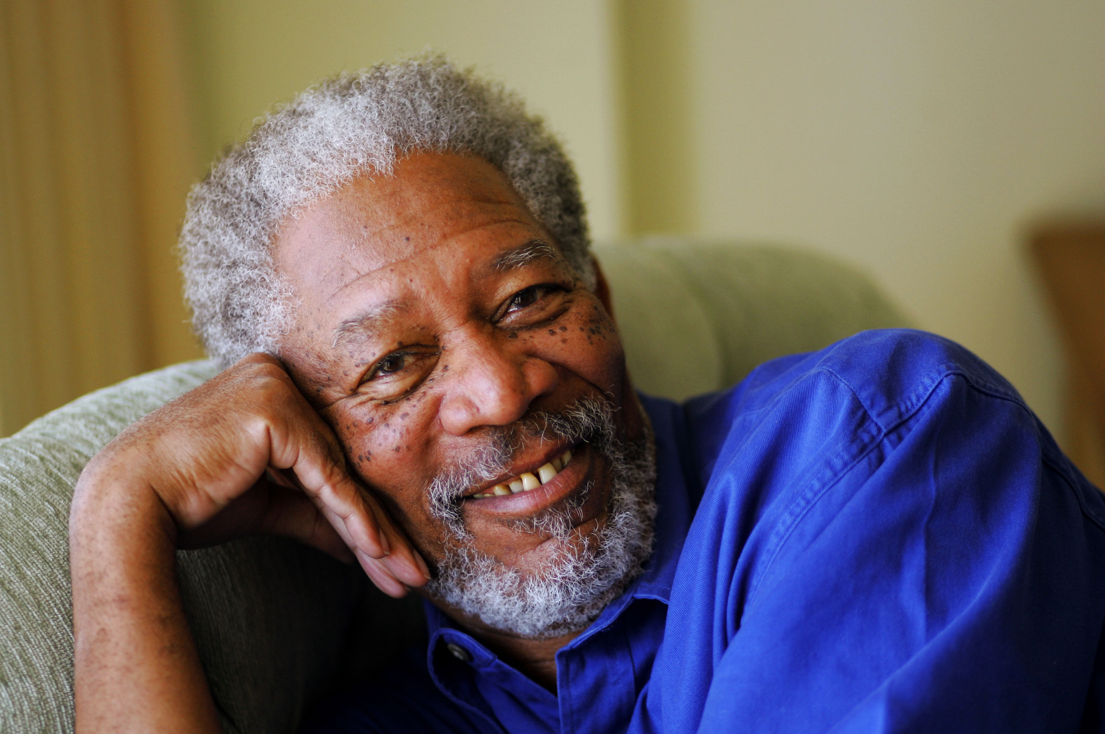
Ben-Hur
Loss of $6,000,000

Slide 3
Ben-Hur must be an anomaly..
The BFG
Alice through the looking glass
The Huntsman
Ghostbusters
Teenage Mutant Ninja Turtles
Deepwater Horizon

Slide 4

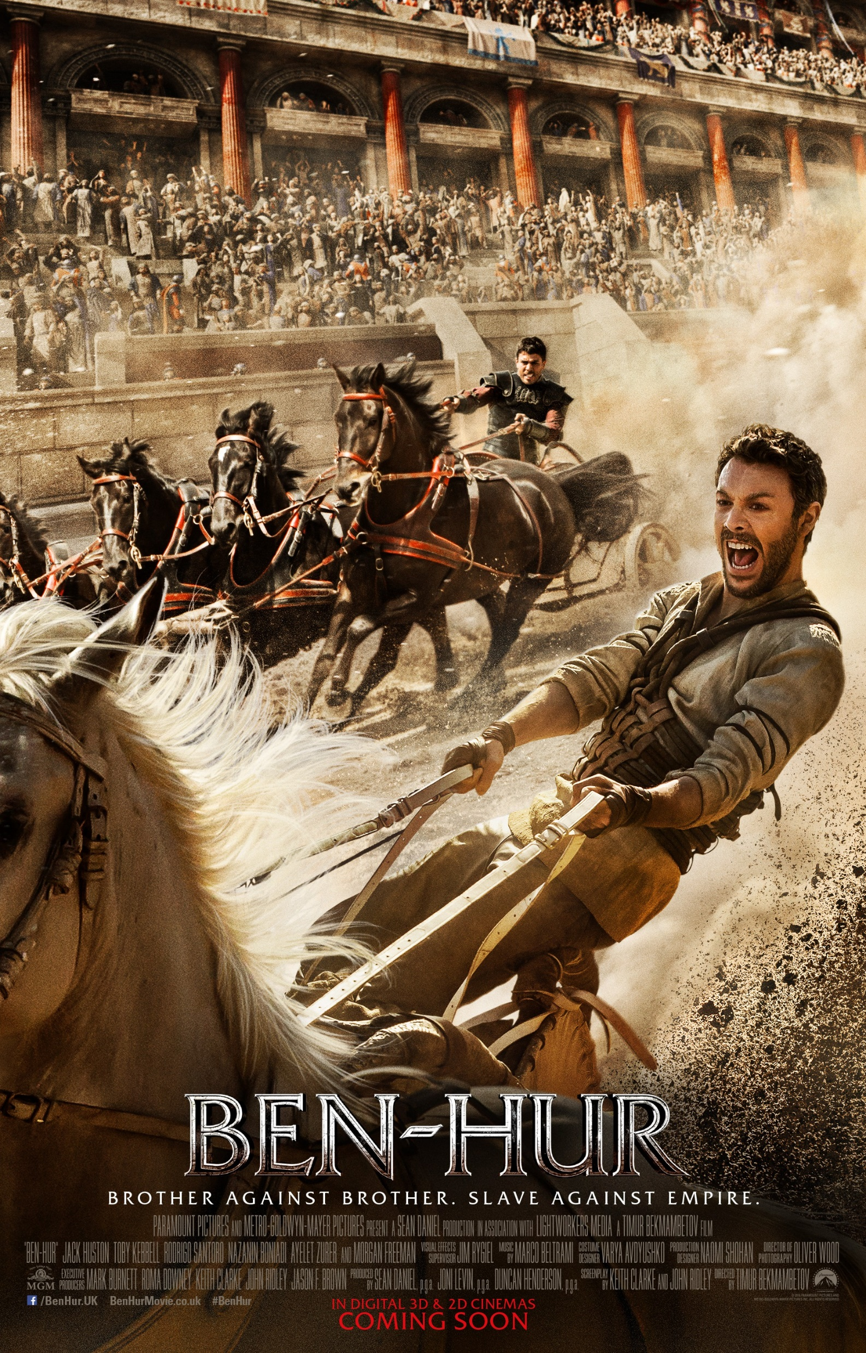
Movie success Indicators?
Actors?
Director?
?
?
?
?
Genre?
Run-time?

Slide 5

Who cares?
ADVICES CLIENTS ON MOVIE
INVESTMENT OPPORTUNITIES

Slide 6


How does that work?
ADVICES CLIENTS ON MOVIE
INVESTMENT OPPORTUNITIES
GAP

Slide 7




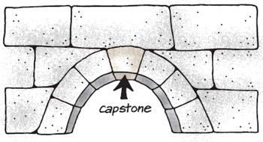

Enter team movie prophet…

Slide 8
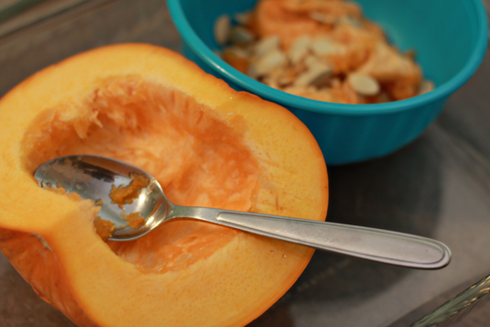
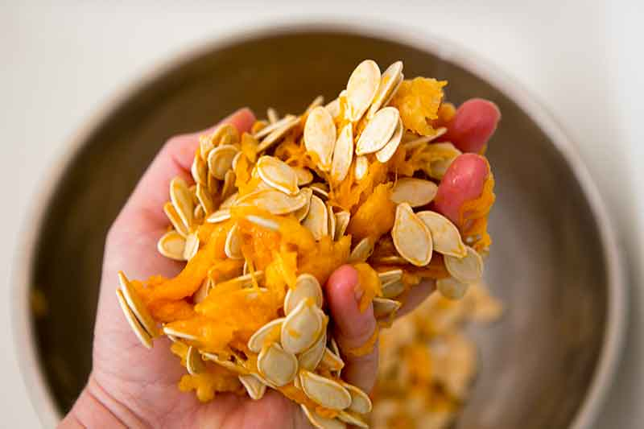
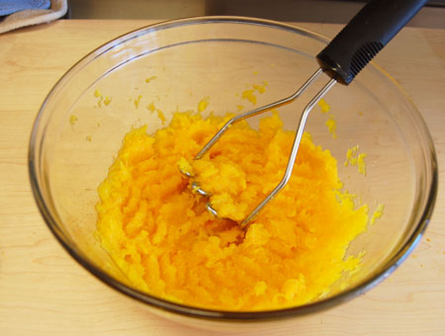
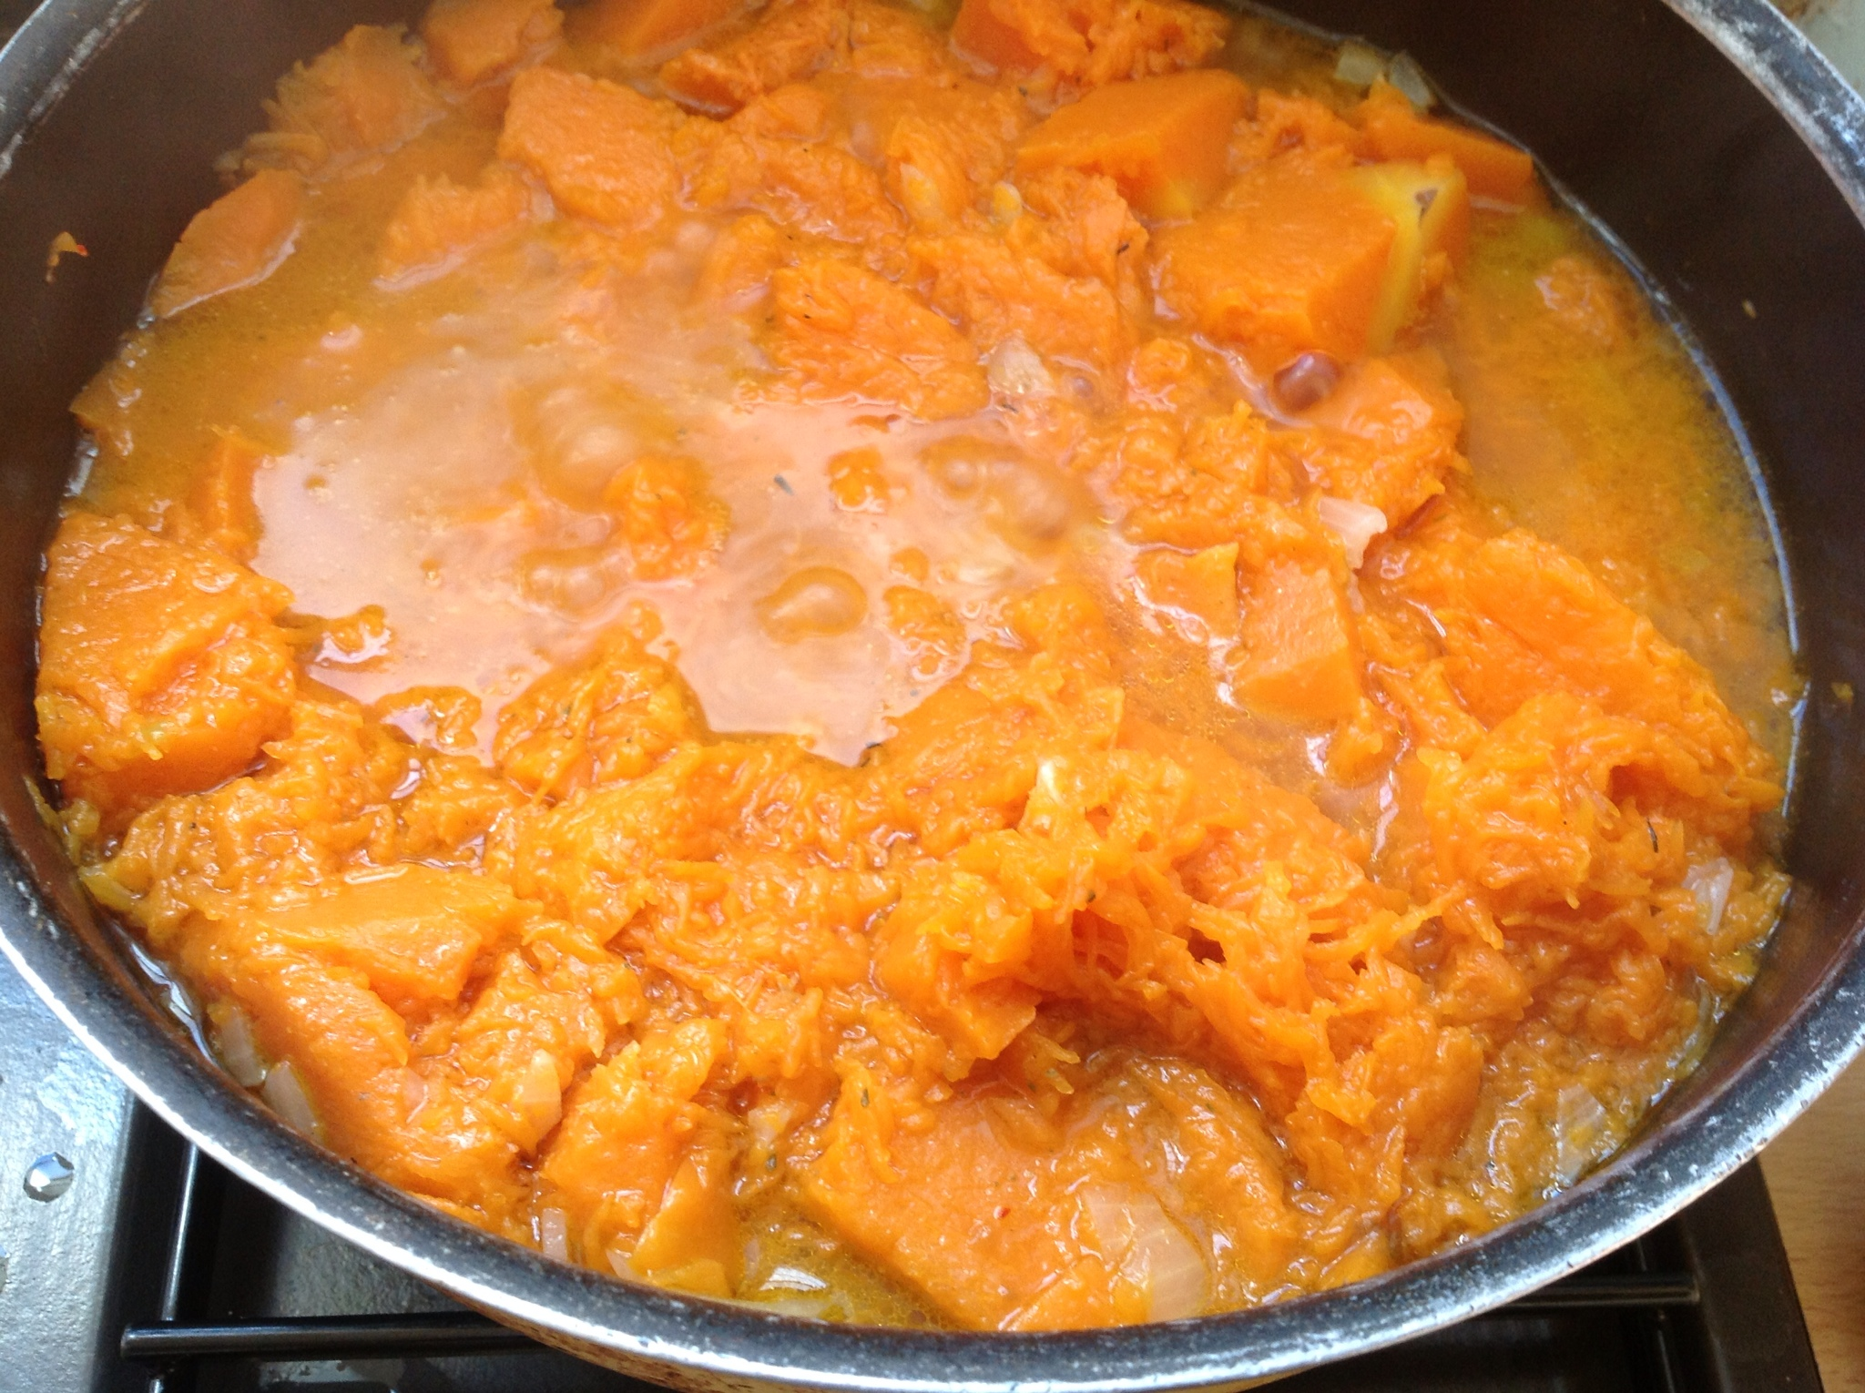
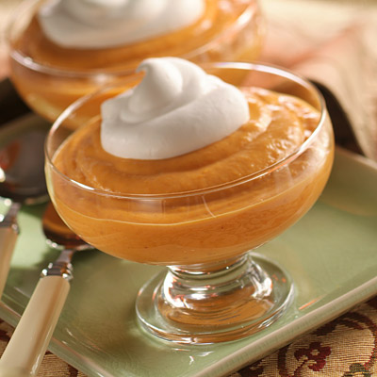
Project Architecture

Slide 9



Scraping

Slide 10

cleaning

Slide 11


Feature engineering
Runtime
Actor Score

Slide 12
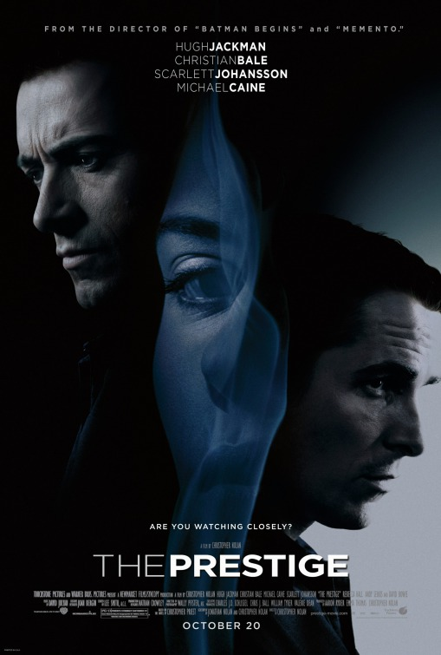
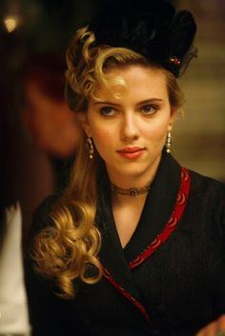
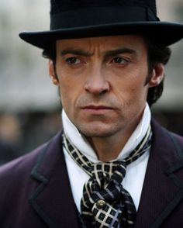
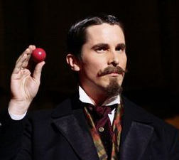
Feature engineering
0.4
0.5
0.5
0.6

Slide 13
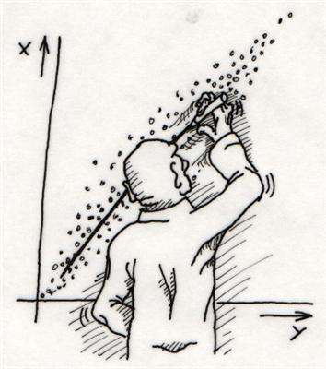
Modeling

Slide 14





Deploying

Slide 15
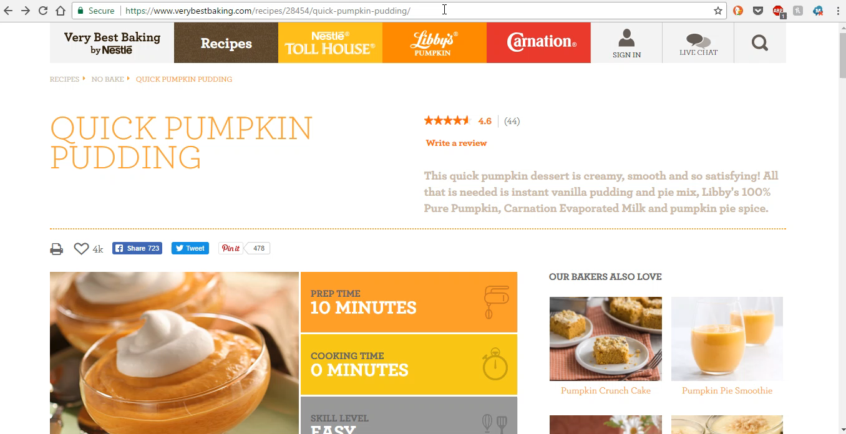
So, is the pudding edible?

Slide 16
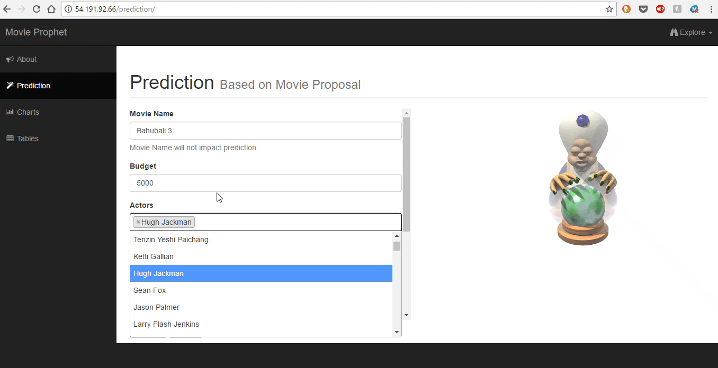
So, is the pudding edible?

Slide 17
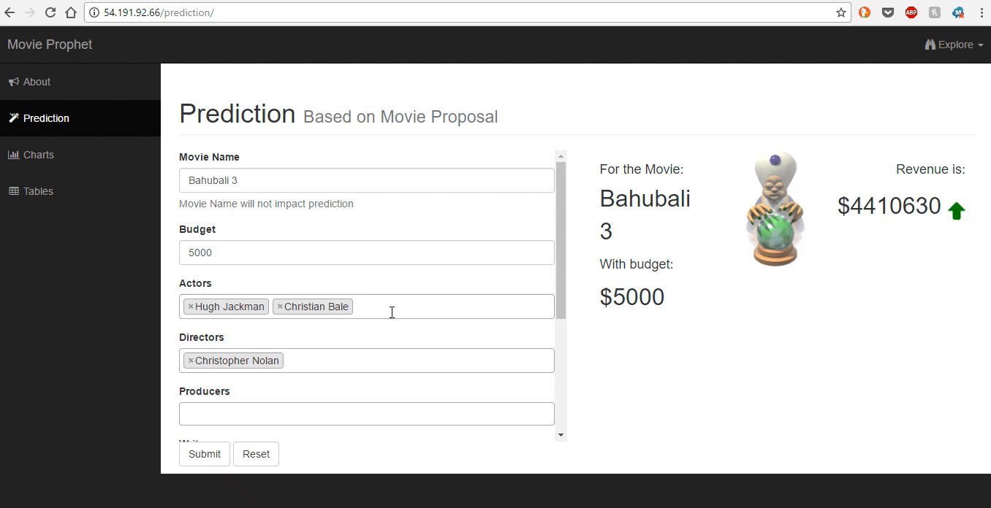
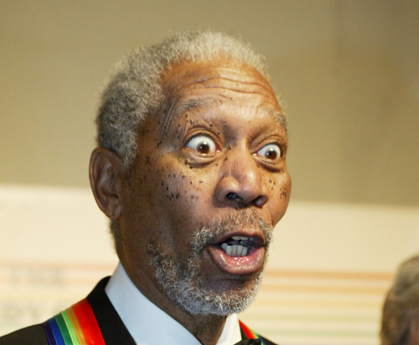
So, is the pudding edible?

Slide 18
Disclaimer: pudding may cause indigestion

Slide 19
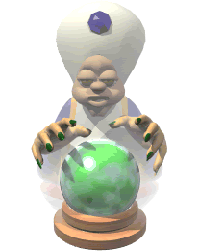
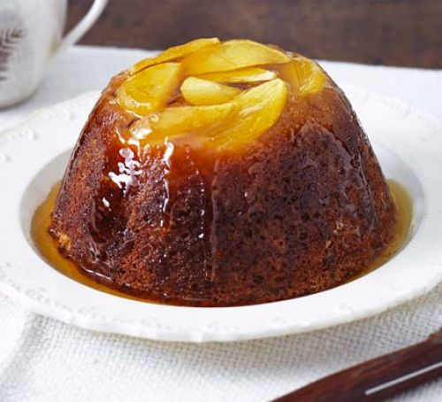
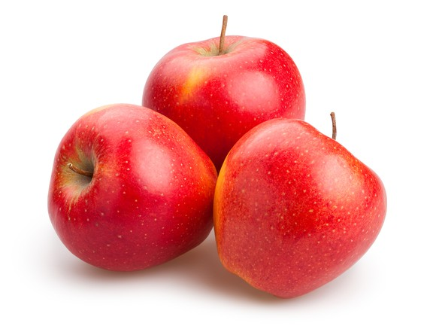
But I want apple pudding…

Slide 20
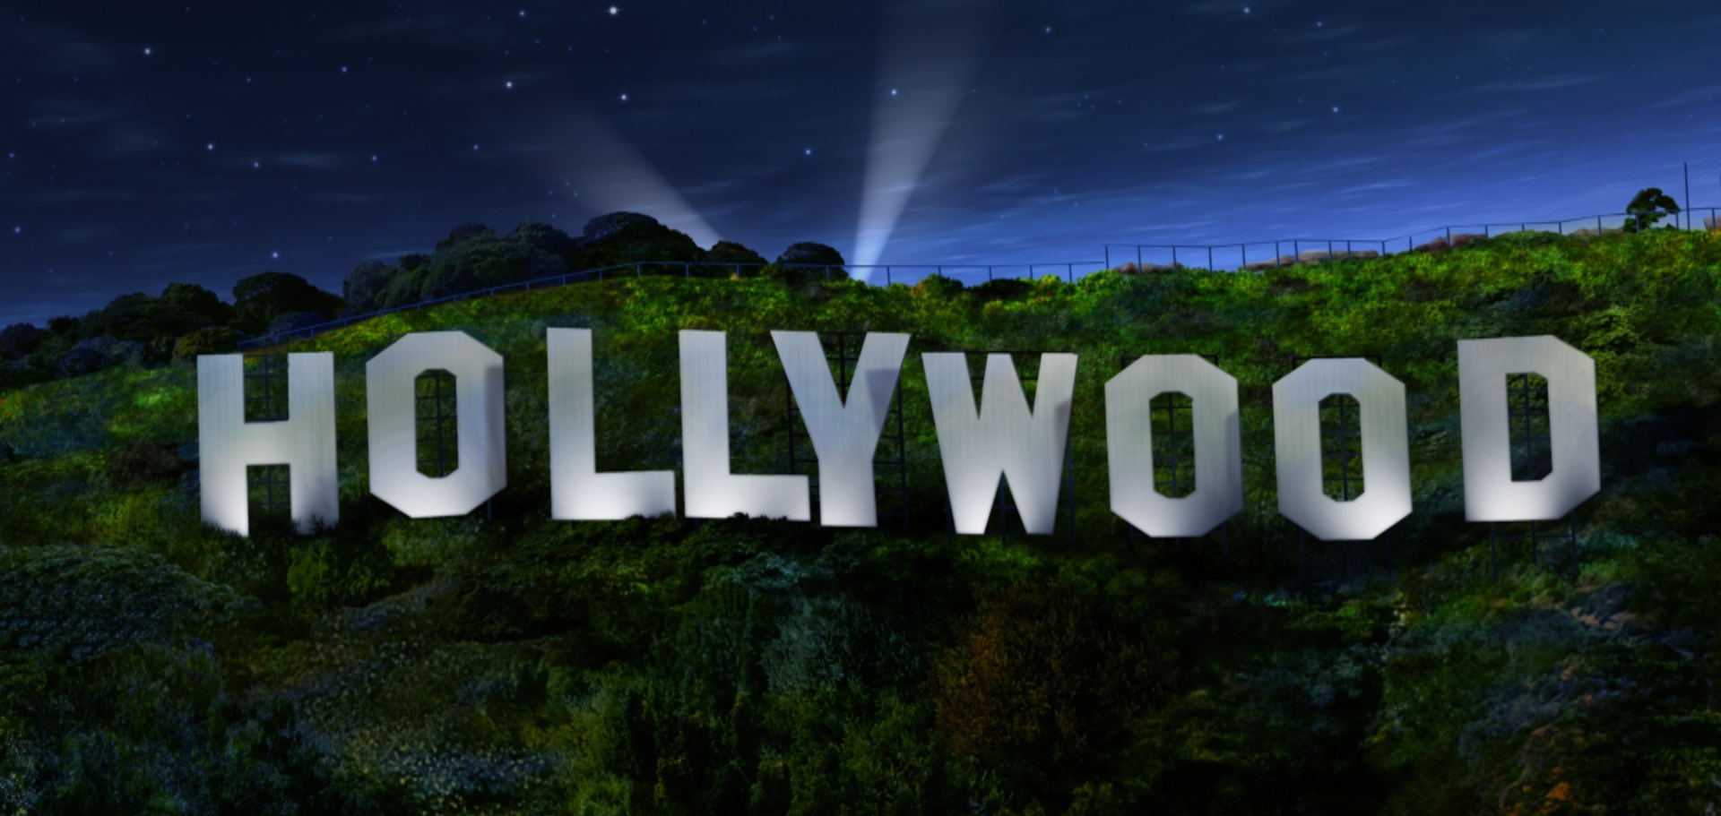

movie prophet

